Slide 1
Unity / Rocket Golf
By Caleb Carlson, Brandon Neff, and Nathan Spaulding

Slide 2
Downloading Unity
See Dr. Ward’s slides for downloading Unity
MAKE SURE TO DOWNLOAD ANDROID BUILD SUPPORT!!!

Slide 3
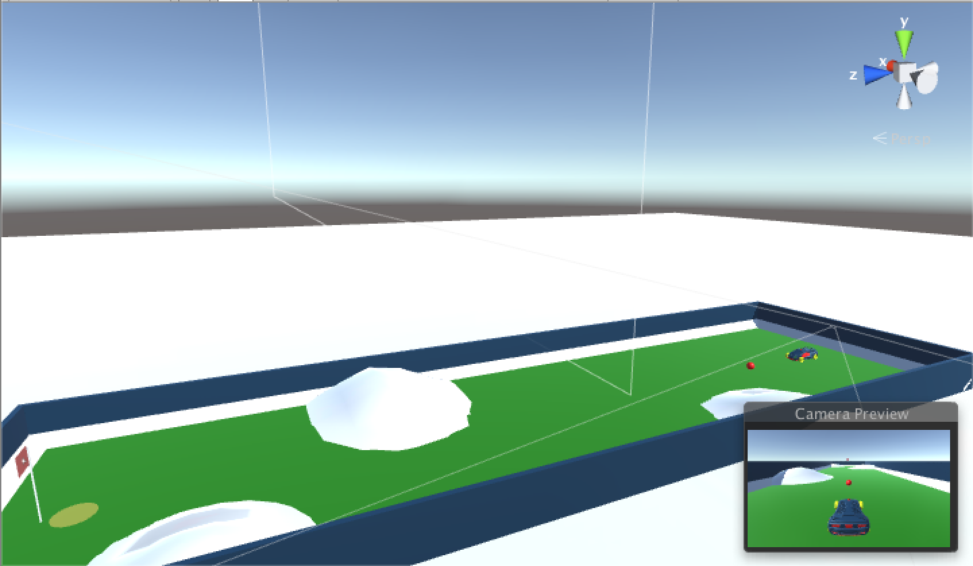
Rocket Golf!!!

Slide 4
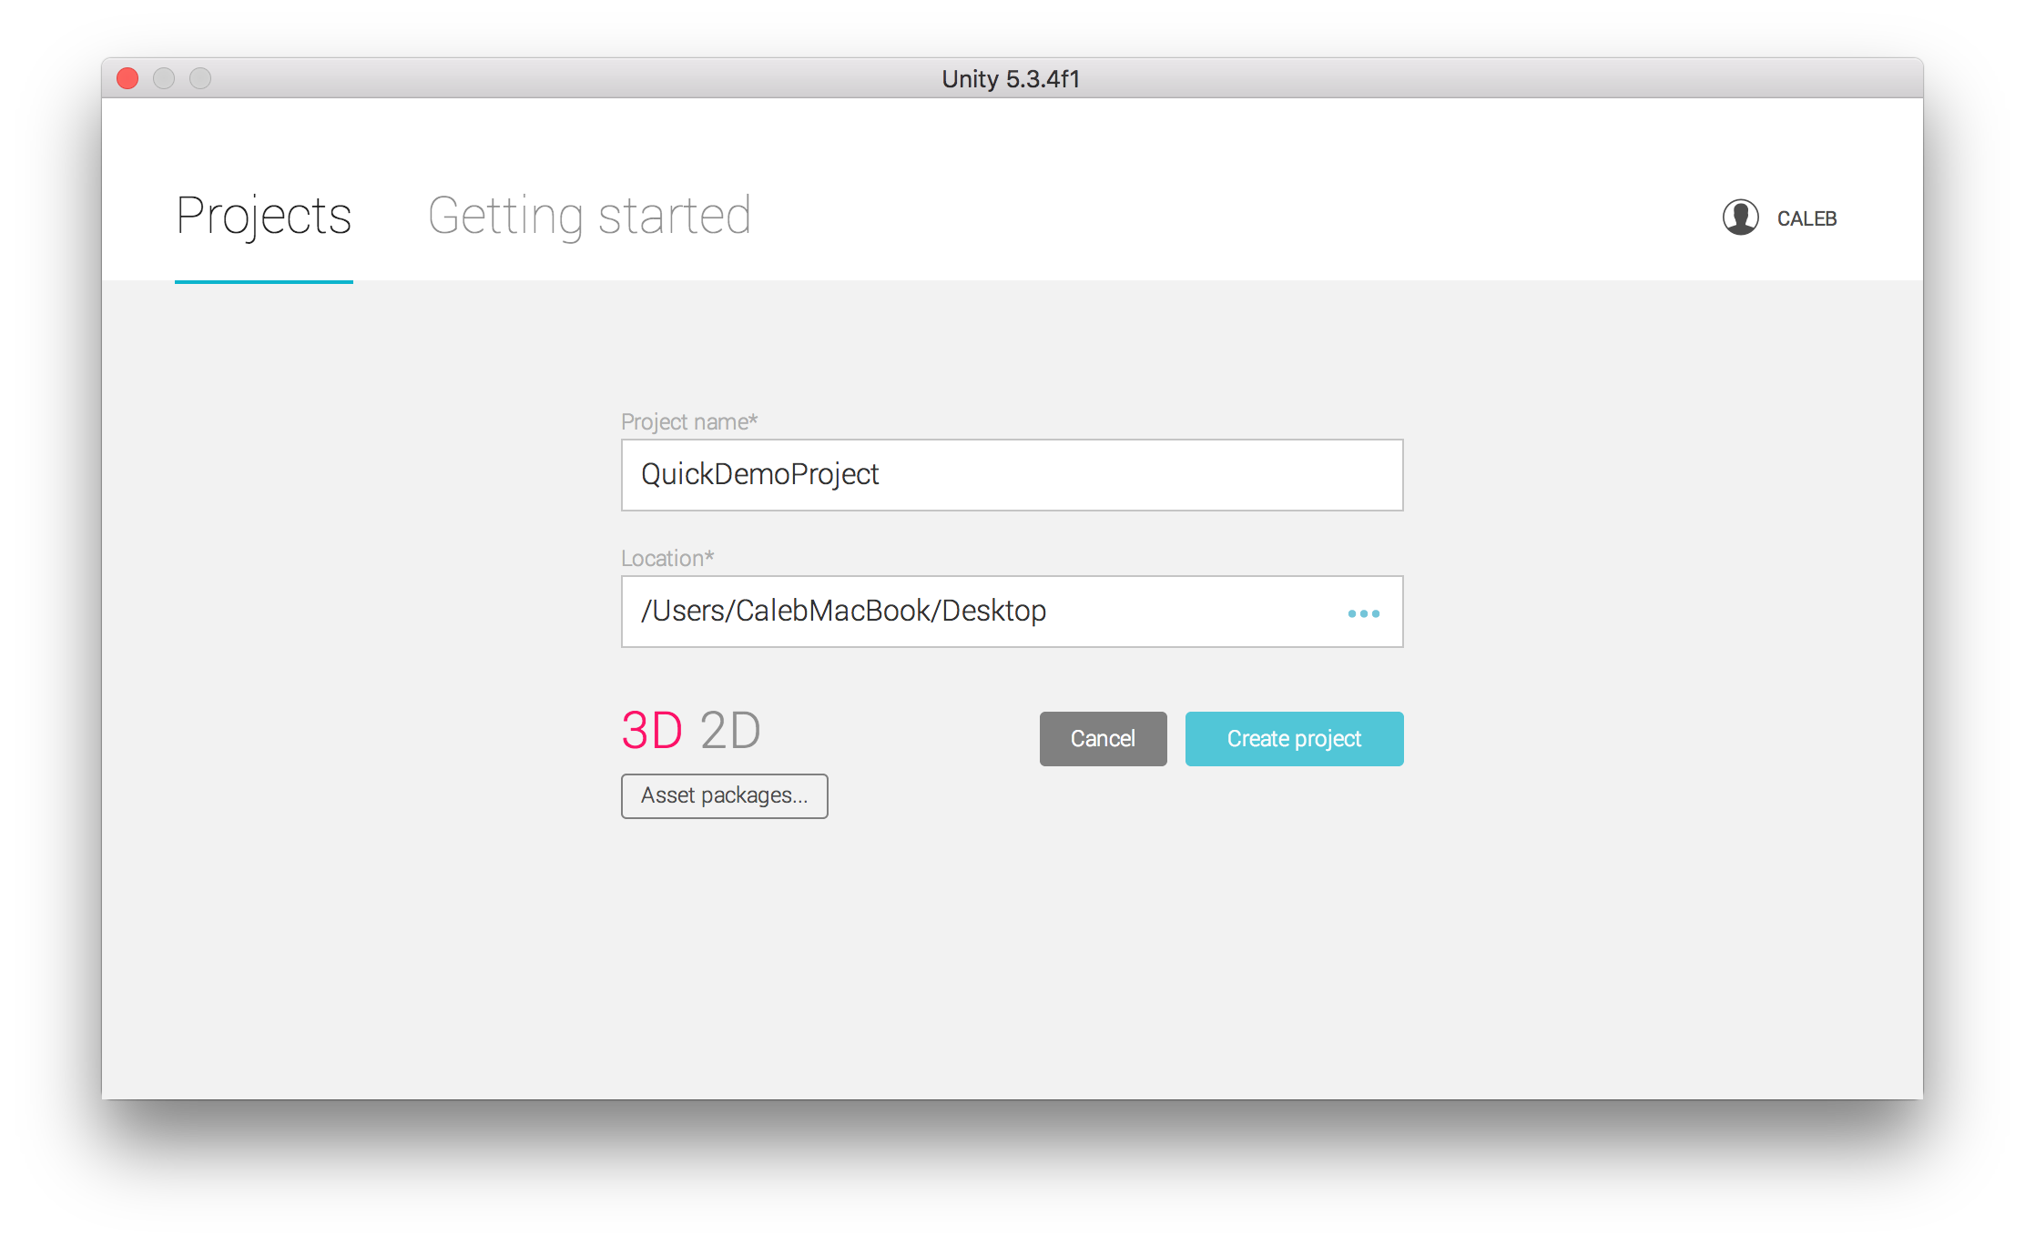
Creating A Project

Slide 5
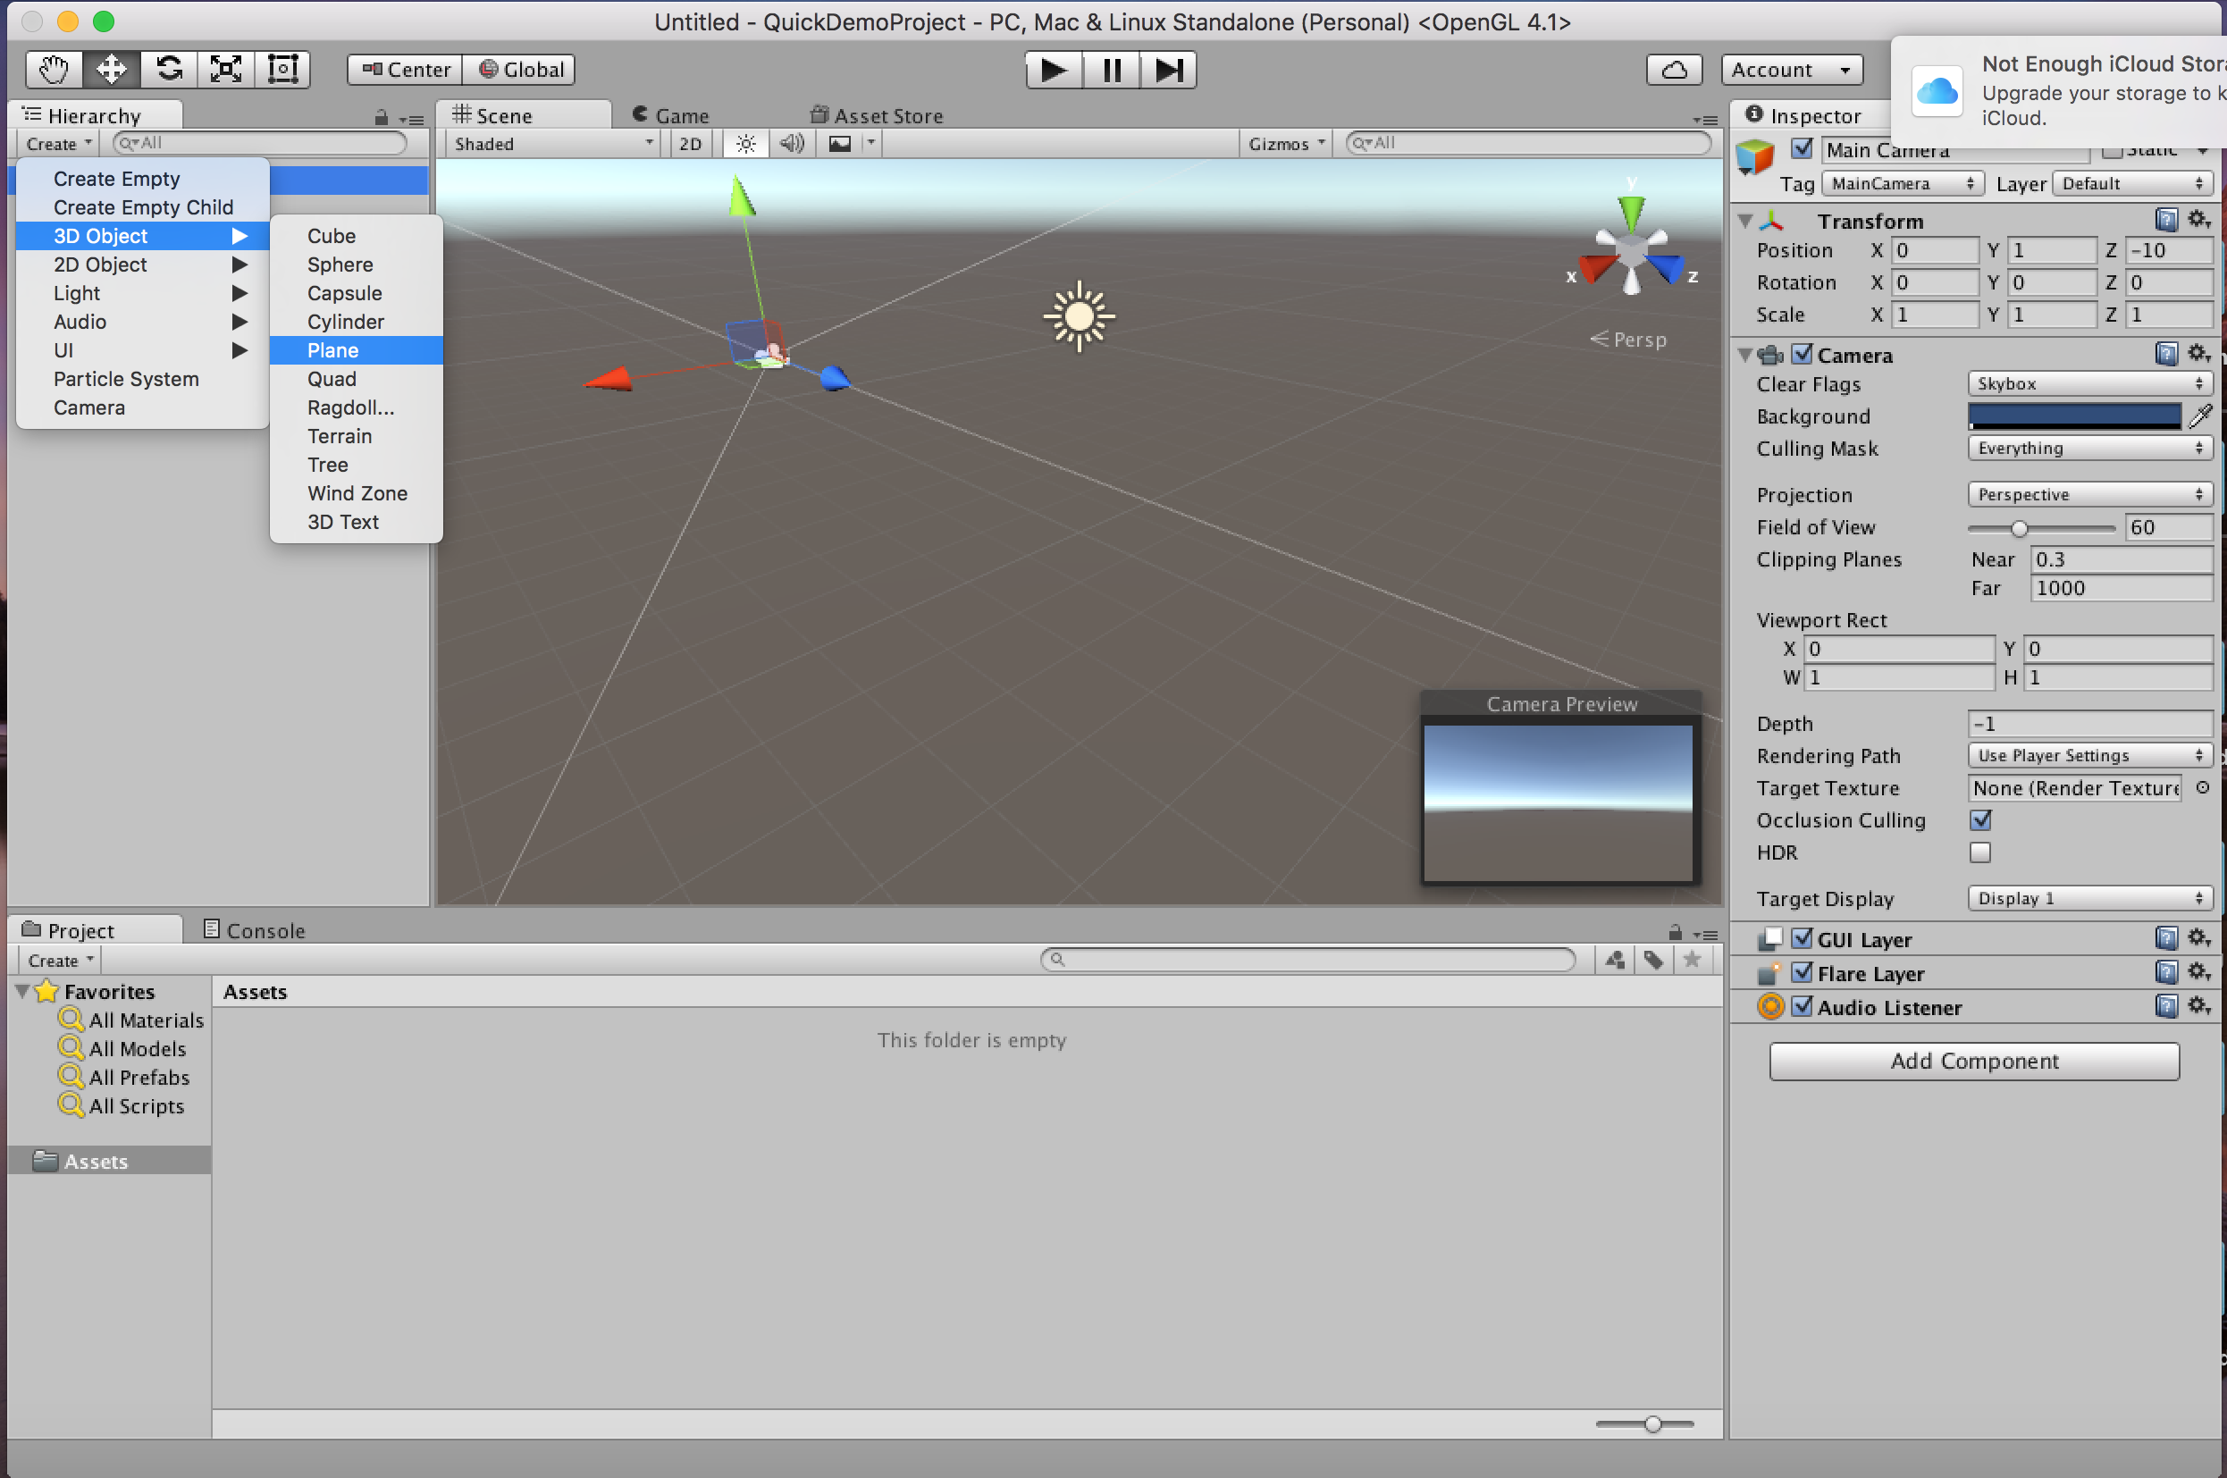
Creating Shapes

Slide 6
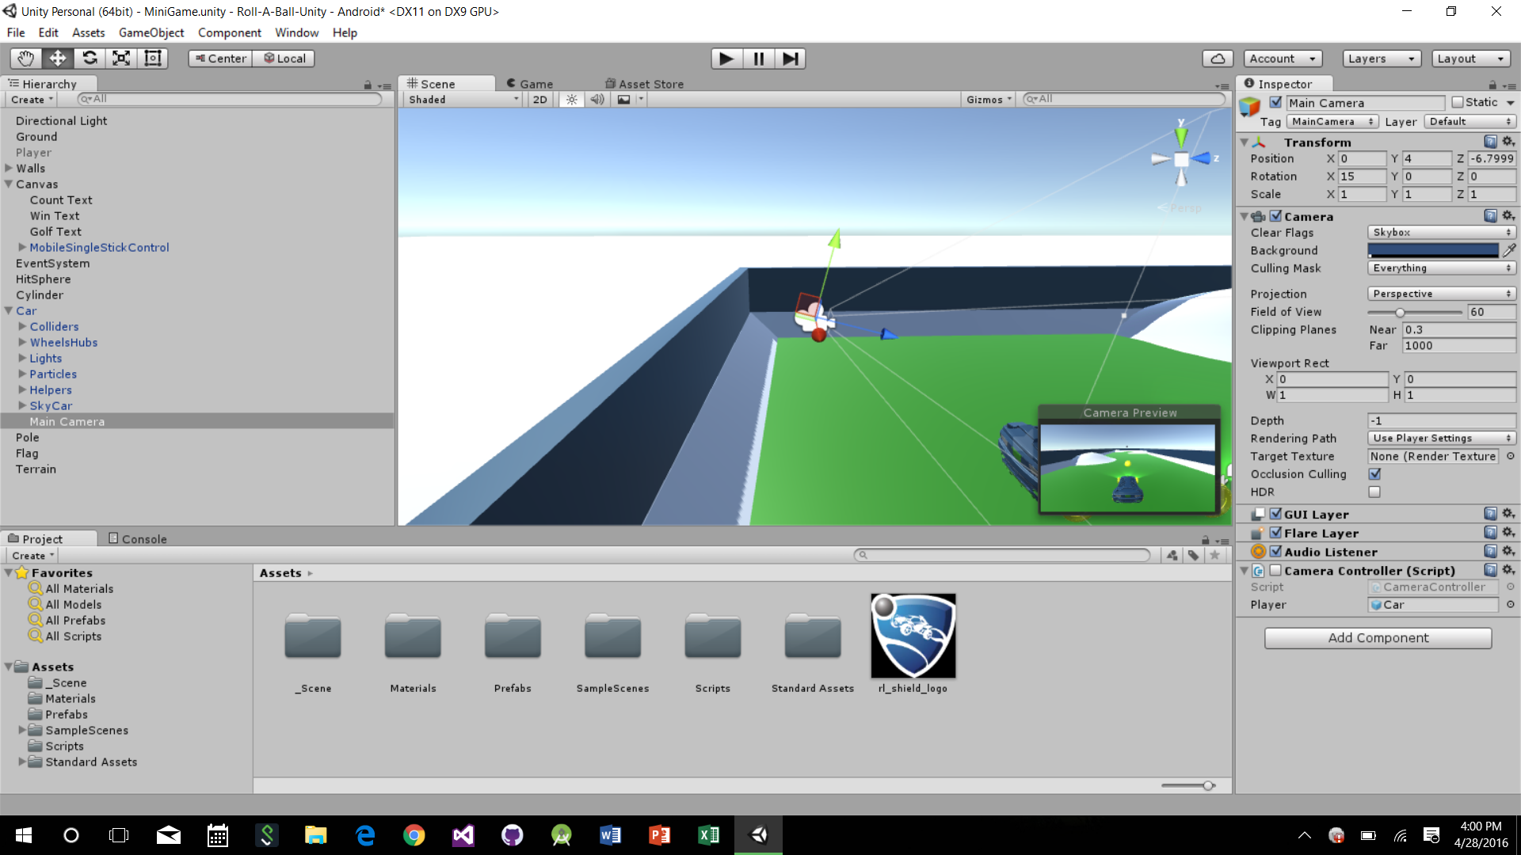
The Camera
Display the content of the entire project to the user.
When a new scene is created, a GameObject is created and the camera is then paired with that object.

Slide 7
Camera Properties
Clear Flags: Determines what the camera displays in the areas where there are no GameObjects. By default Skybox is used, if there is no Skybox, the camera defaults to a solid color
Culling Mask: Determines what layers are picked up by the camera.
Projection: How the camera sees the world. Perspective (3D) and Orthographic (Flat).
Clipping Planes: Dictates the range where objects are visible to the camera. Objects that are too close or too far away will not be seen.
Depth: Used for multiple cameras. Low depth are drawn first.

Slide 8
Camera Script to track the ball
public GameObject player; private Vector3 offset; // Use this for initialization void Start () { offset = transform.position - player.transform.position; } // Update is called once per frame void LateUpdate () { transform.position = player.transform.position + offset; }

Slide 9
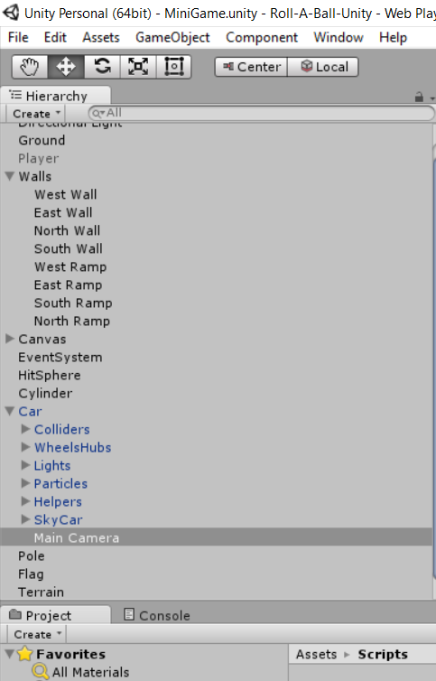
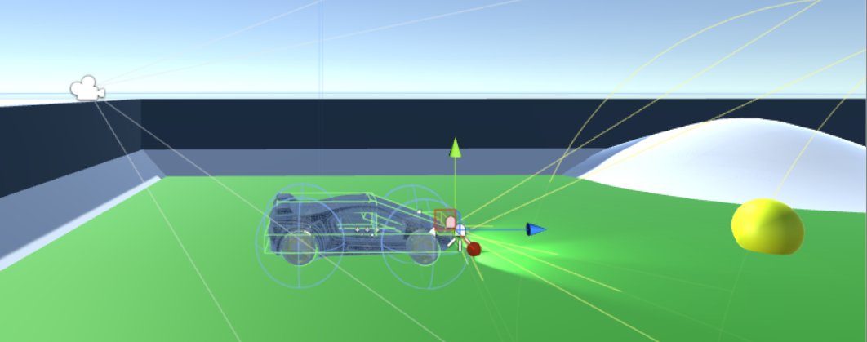
Fixing Camera Location

Slide 10
Changing Cameras
var cam1 : Camera;
var cam2 : Camera;
function Start() {
cam1.enabled = true;
cam2.enabled = false;
}
function Update() {
if (Input.GetKeyDown(KeyCode.C)) {
cam1.enabled = !cam1.enabled;
cam2.enabled = !cam2.enabled;
}
}

Slide 11
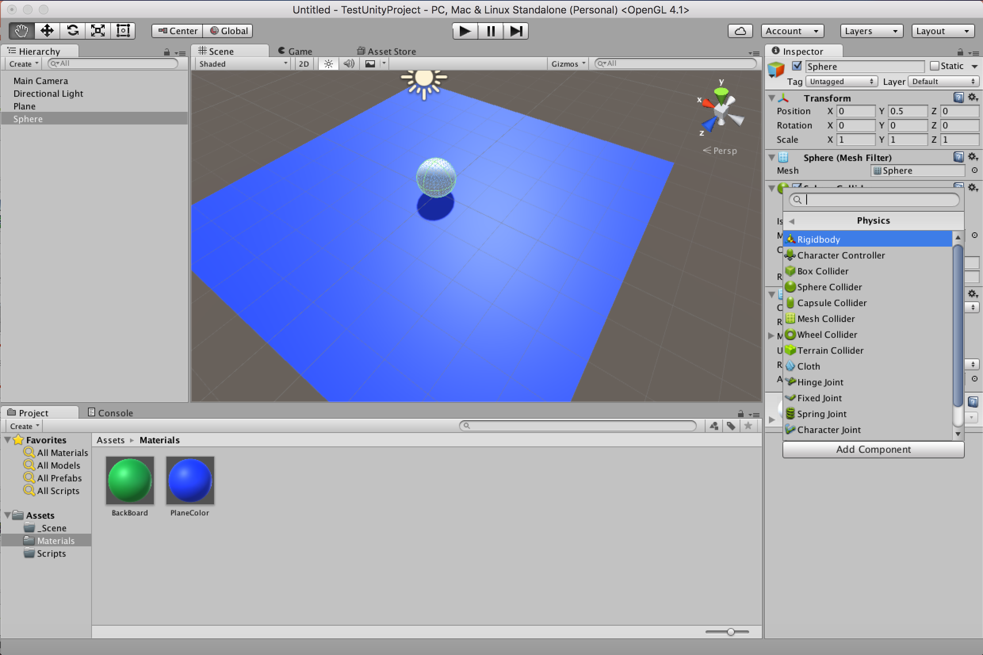
Physics
To get an object to animate you need to add a Rigidbody to you object. This is the basic 3D Physics component to get your object to act to collisions and gravity.

Slide 12
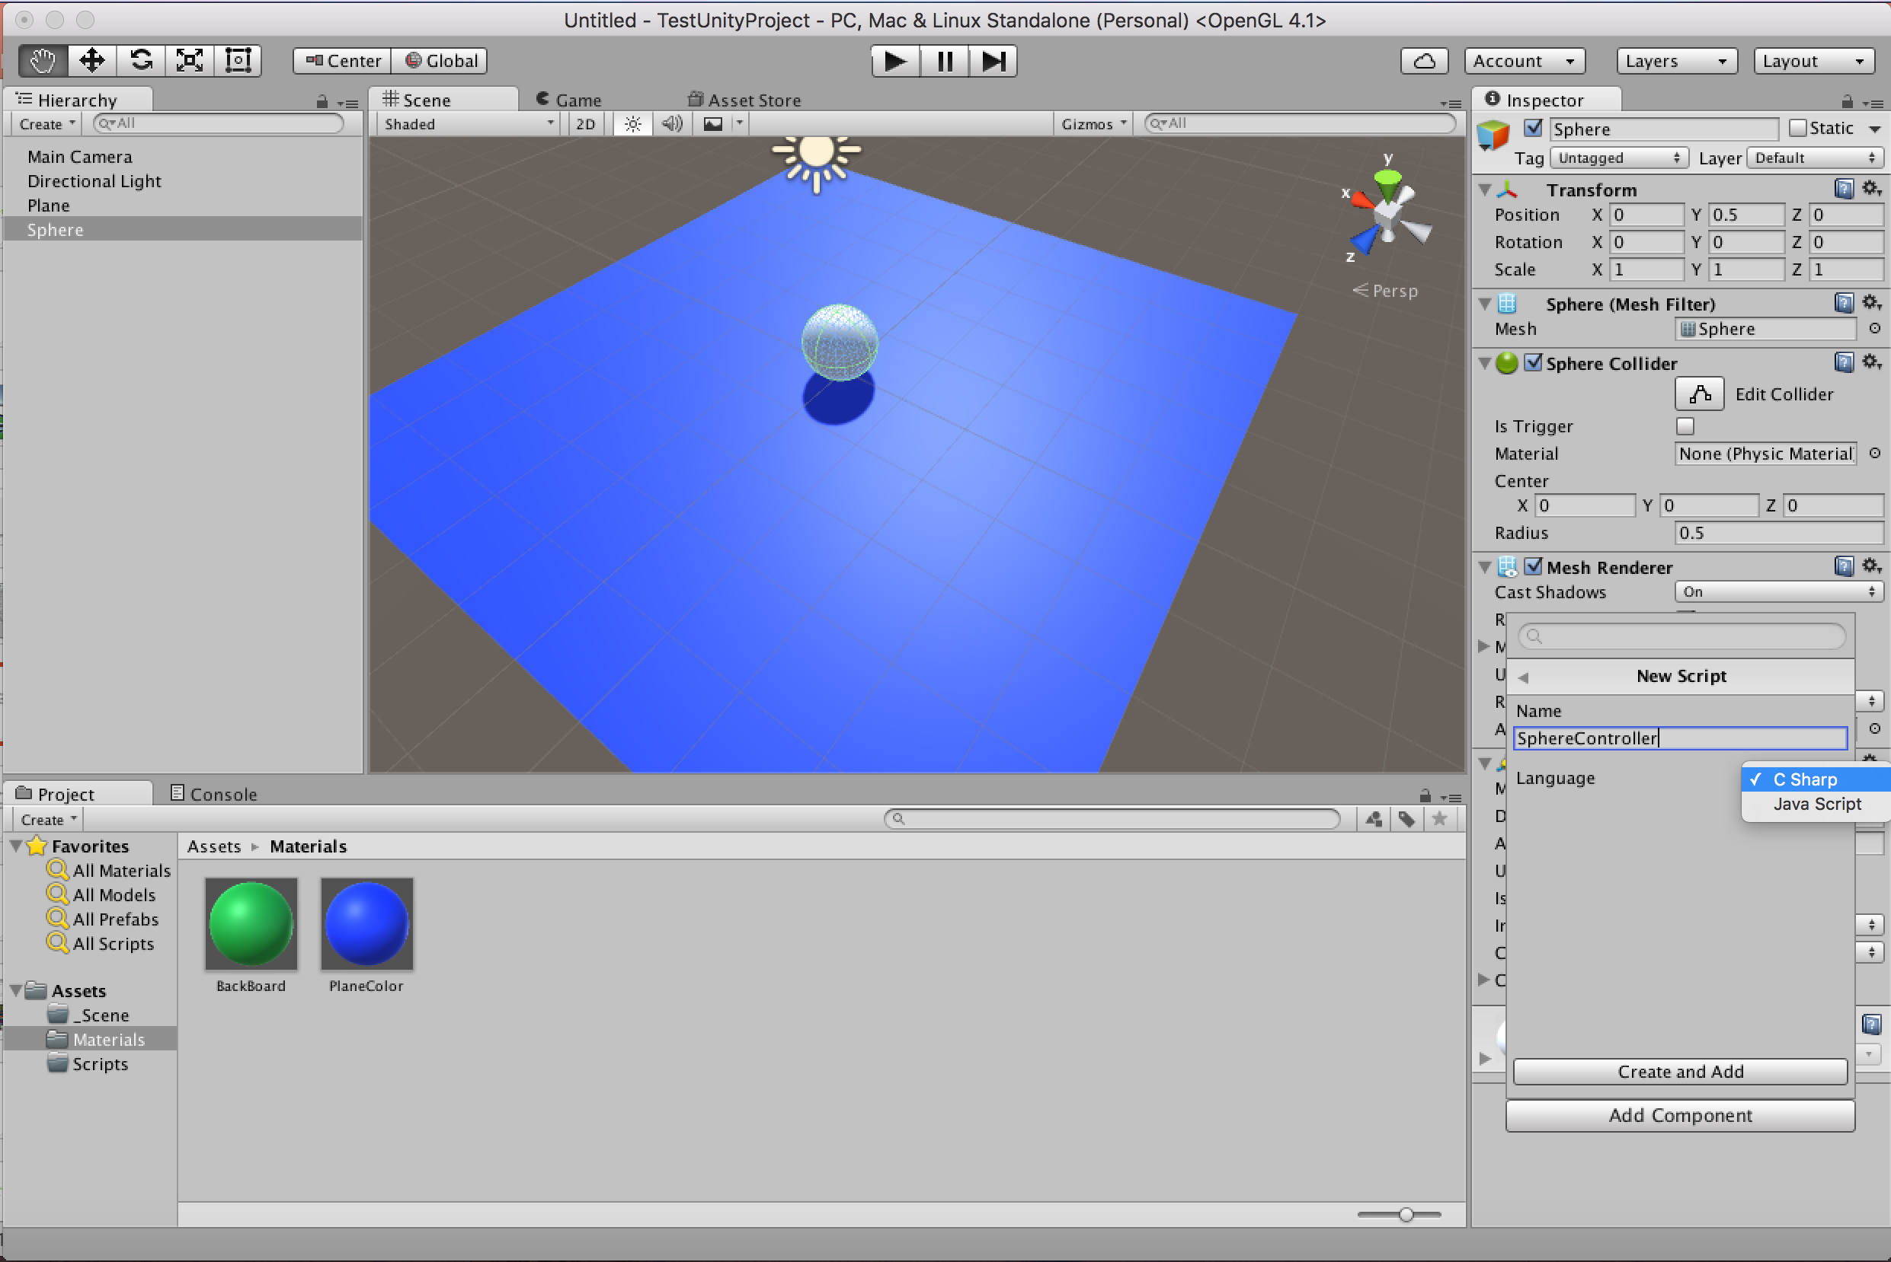
Scripts
Scripts allow you to modify how objects interact with each other beyond the basic collision.

Slide 13
Two Types Of Contact: Collision vs Trigger
Triggers are used when you want to objects to overlap and “collect” each other
Collisions are meant for when objects are going to collide and have physics forces act on each shape

Slide 14
To the project!

Slide 15
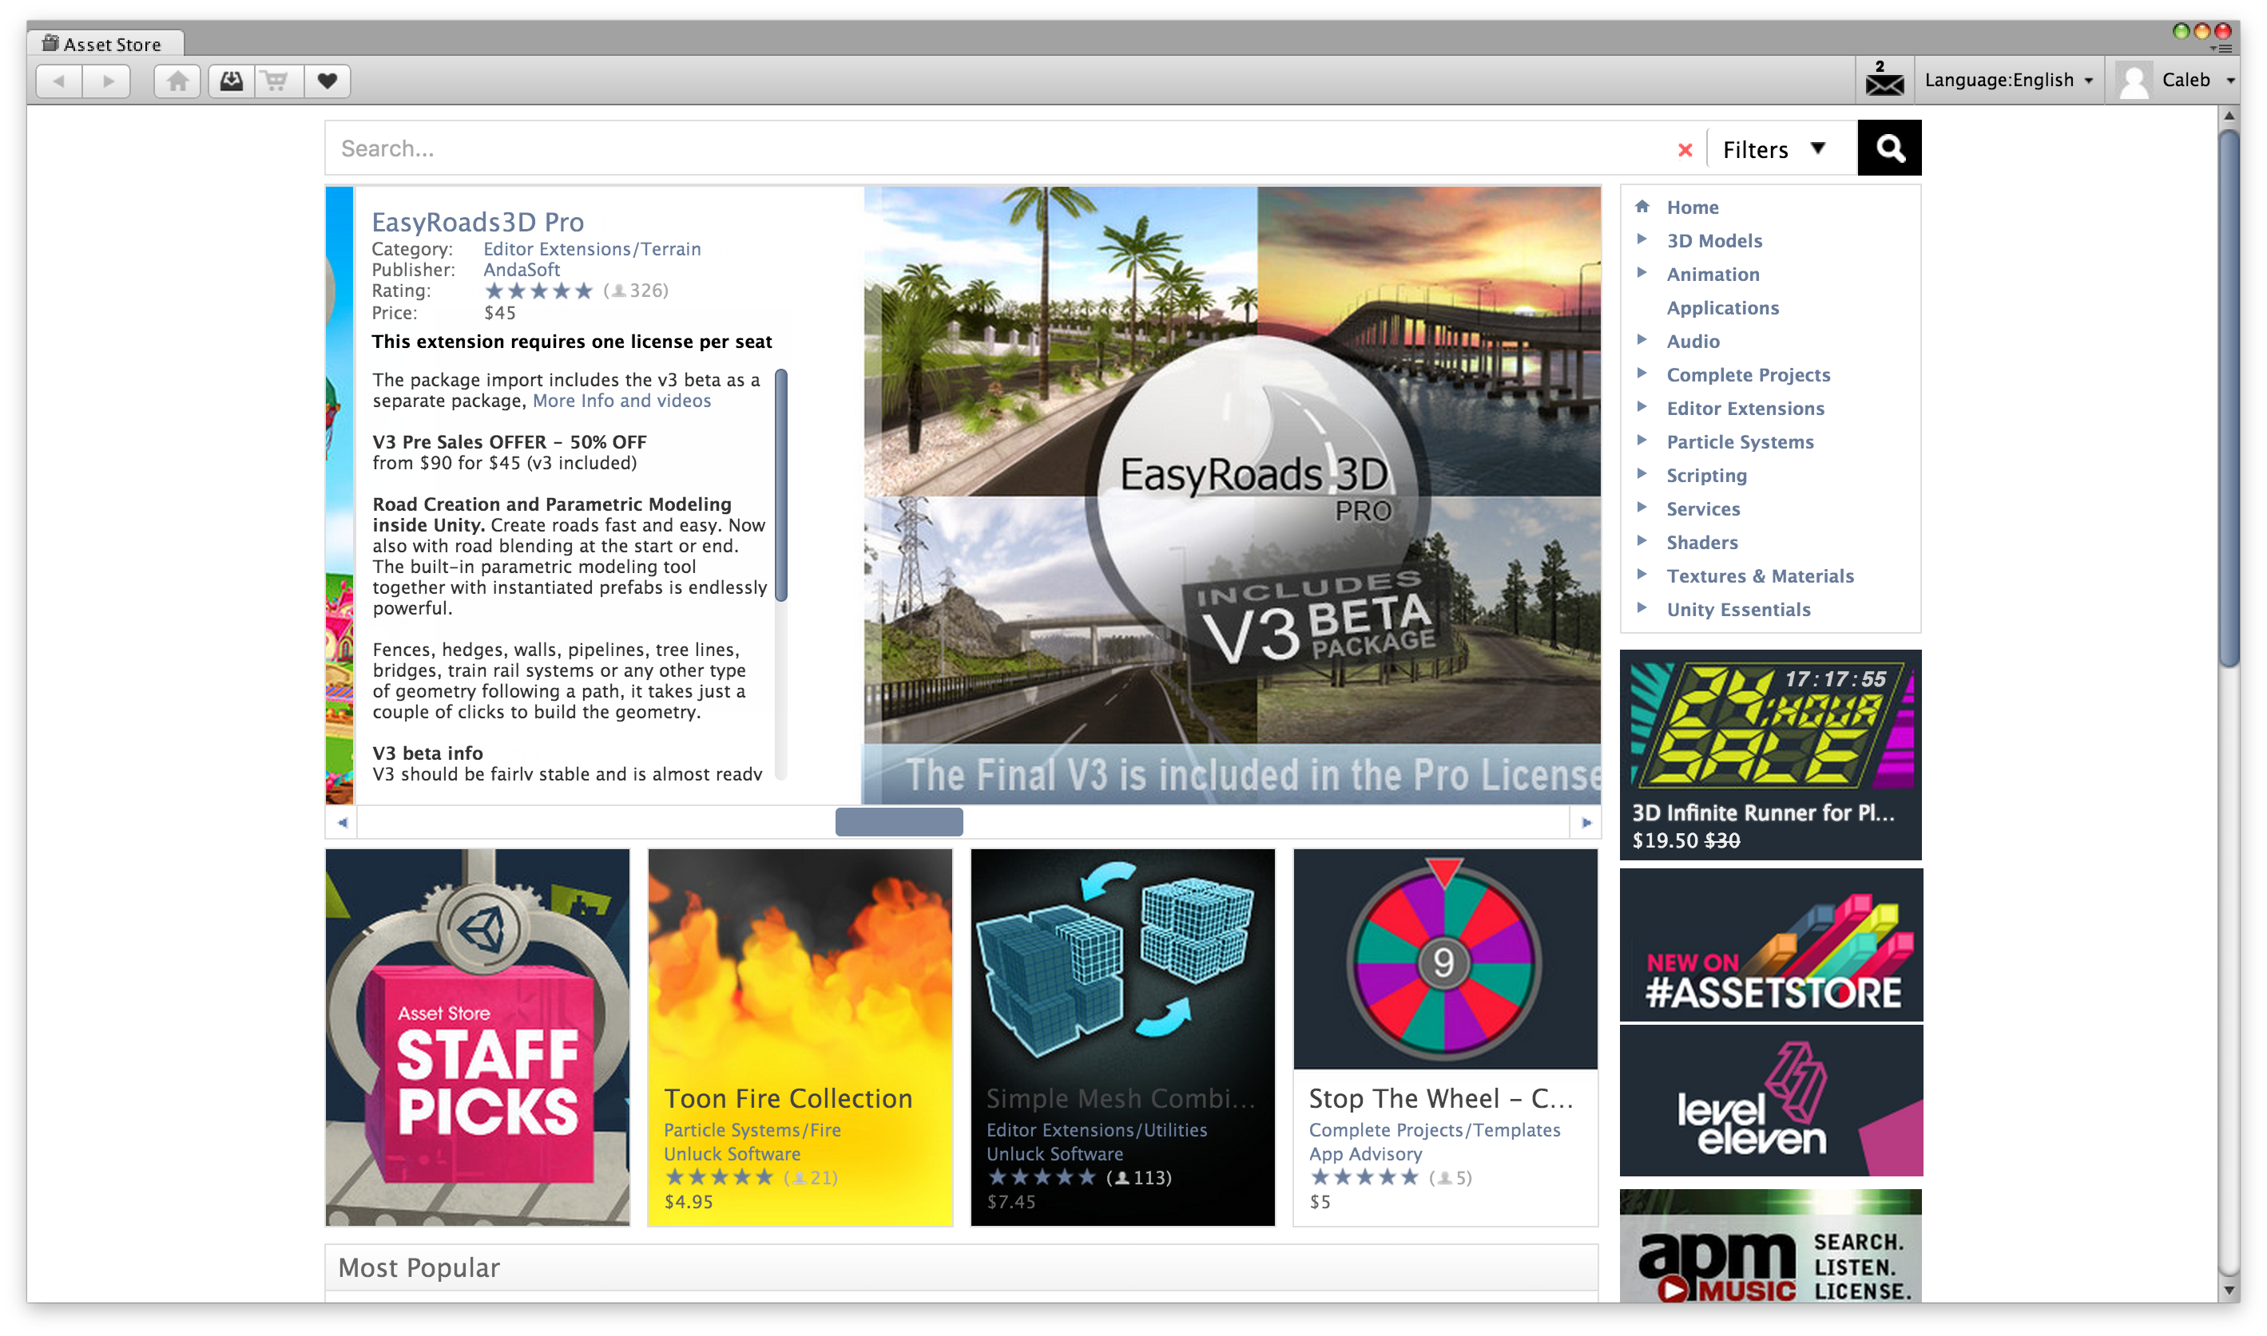
How did we make that awesome car??? We didn’t… Assets Store

Slide 16
Adding textures, trees, and more has never been easier!

Slide 17
Exporting the project!

Slide 18
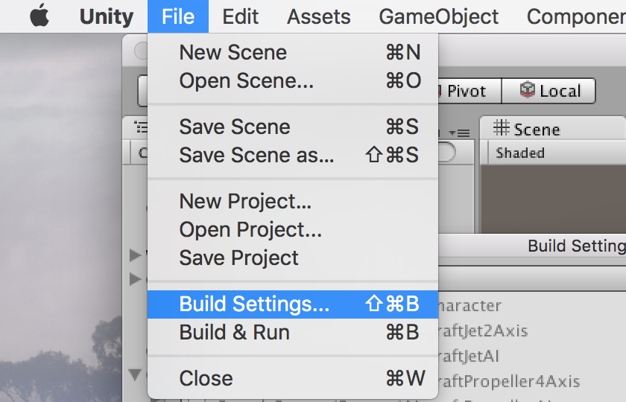
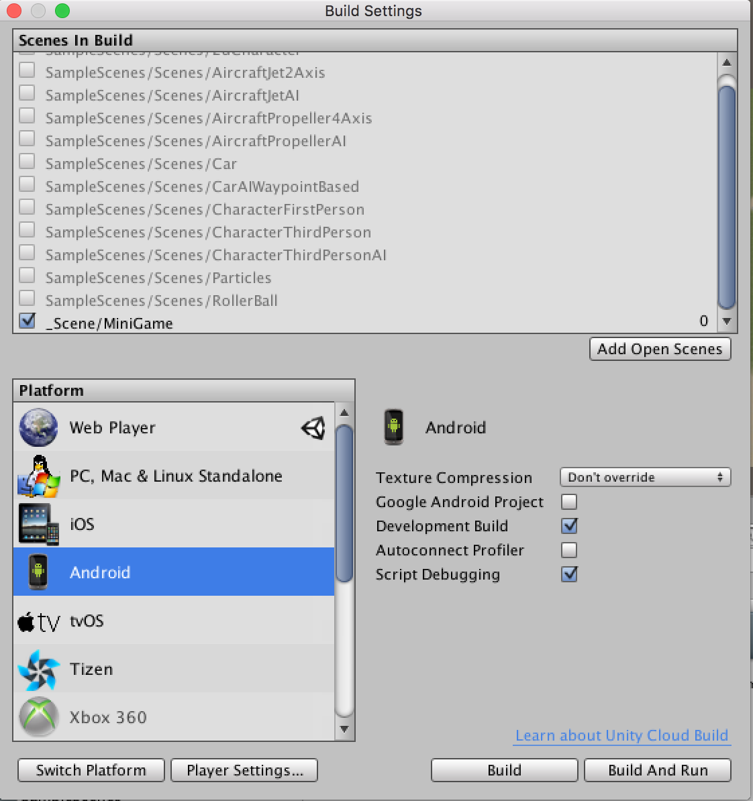
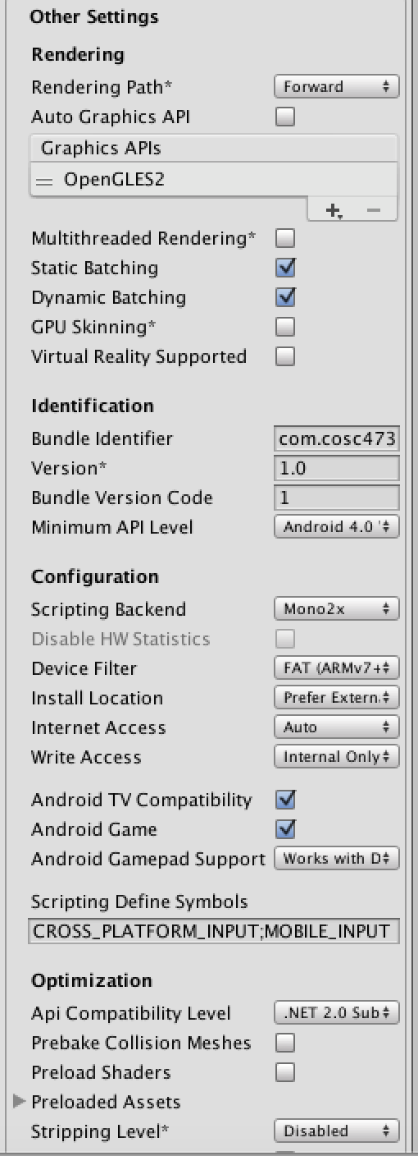
Exporting the project!

Slide 19
Building in Android
Back to the project!

Slide 20
It even works on IOS devices
Back to the project!

Slide 21
References
http://unity3d.com/learn/tutorials/projects/roll-ball-tutorial (Great tutorial for game basics)
http://docs.unity3d.com/Manual/index.html (Unity Manual)
https://www.assetstore.unity3d.com/en/ (Asset Store)
Unity Game Development in 24 Hours Book

Slide 22
Play the game that inspired it all….

Slide 23
Q & A

